Slide 1
V & V
(Verification & Validation)

Slide 2
01
引言
目录
CONTENT
如何理解V&V实际发挥的作用
02
V&V的内容和特性
什么是V&V，为什么V&V是有效的
03
V&V的过程模型
V模型及W模型的介绍

Slide 3

V&V的定义
V&V（Verification and Validation）
在软件项目管理，软件测试和软件工程中，验证和确认（V＆V）是检查软件系统是否符合规范并且满足其预期目的的过程。
它也可以称为软件质量控制。

Slide 4
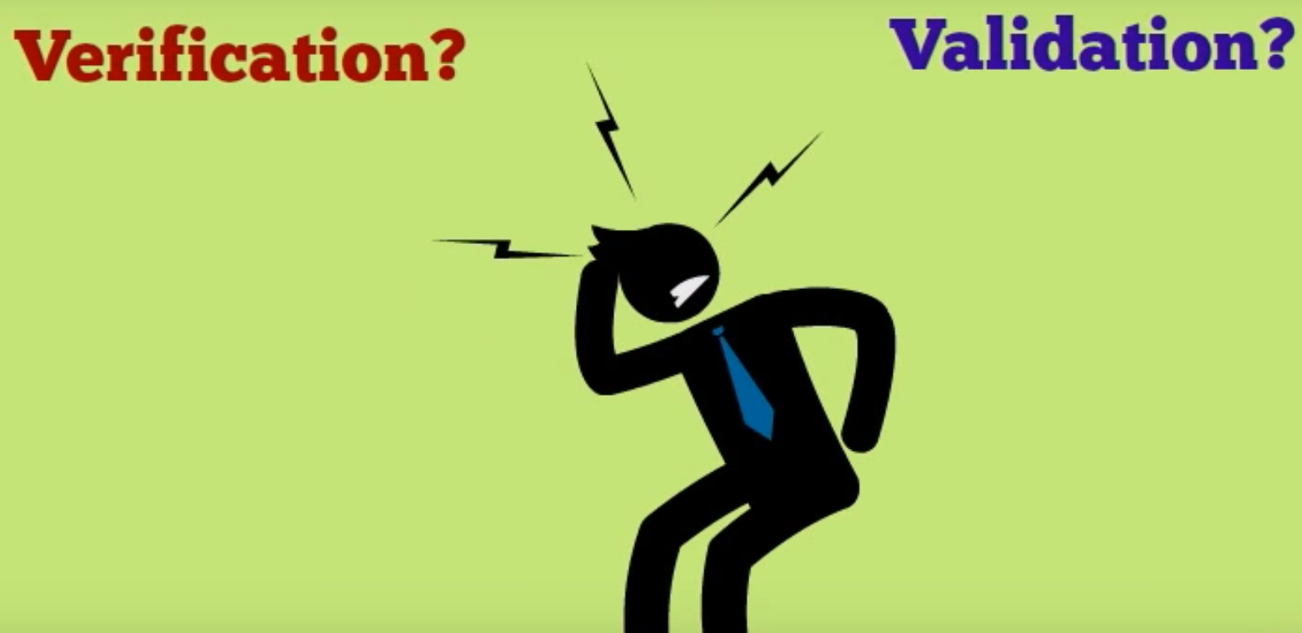
验证和确认是不相同的
验证和确认是不同的概念
验证指的是通过检查和提供证据来证实产品规定需求已经得到满足的过程。
确认指的是通过检查和提供证据来证实对产品某一特定预期用途的需求已经得到满足的过程。

Slide 5

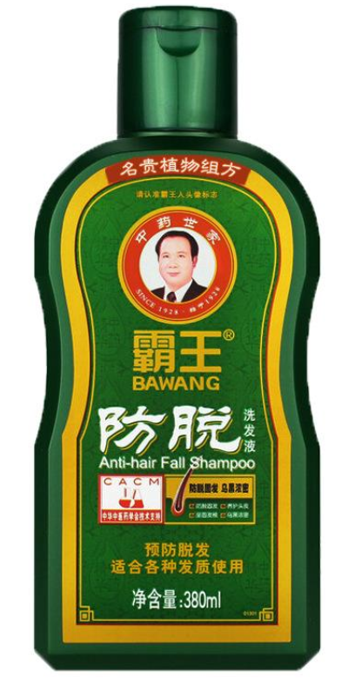
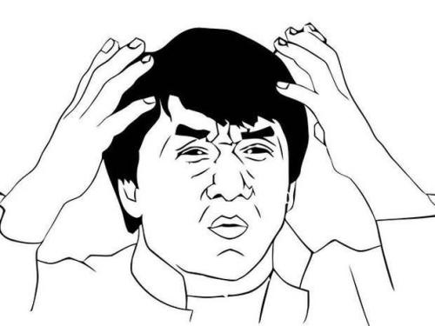
例子：成龙洗发水广告
? ? ?
如何保证这款洗发水是可信的？
BBC关于中国新字的报道

Slide 6






引子：成龙洗发水广告
验证
确认
公司及监察部门
的质量检验
客户的使用测试

Slide 7
什么是软件检验和验证
验证(Verification)
确认(Validation)
检验软件是否已正确地实现了产品规格书所定义的系统功能和特性。
提供证据来表明软件相关产品与所有生命周期活动的要求相一致。
验证为判断每一阶段生命周期活动是否已经完成，及能否启动下一个生命周期活动建立了一个新的基准。
包含一系列保证所生产的软件能够追溯到用户需求的活动。
确认过程要提供证据，来表明软件已经满足客户需求，并解决了相应的问题。
一个更准确的说法是“有效性确认”

Slide 8

V&V的直观解释
我们是通过正确的方式生产吗？
&
我们生产了正确的产品吗？
Verification
确认的目的是试图去证实我们开发的工程产品是否是客户所期望的那样
Validation
Process-related
activities
Product-related
activities
验证的目的是保证产品在生产的每个流程都能满足规范和项目的特定需求

Slide 9
Differences between Validation & Verification
Validation
Verification
Are we building the right product?
Are we building the product right?
Notes:
软件确认(Validation)指的是在开发过程中或在开发过程结束时评估软件以确定它是否满足指定需求的过程。它更倾向于关注“Are we building the right product?”，这意味着需要创建一个需求规范，其中包含软件产品的利益相关者的需求和目标，来保证所生产的软件满足客户需求并且解决了相关的问题。
软件验证（Verification）指的是评估软件以确定给定开发阶段的产品是否满足该阶段开始时所规定的条件的过程。，它倾向于关注“Are we building the product right？”，即检验软件在其开发生命周期过程内是否都走在正确的道路上，最终软件是否正确实现了产品规格说明书所定义的系统功能和特性。

Slide 10
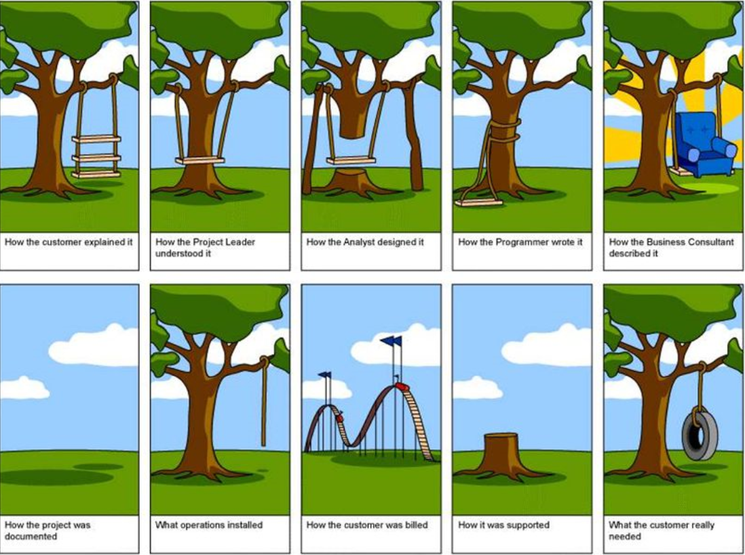
为什么V&V是重要的
很难描述用户的真实需求
在很多时候，一个工程可以通过全部的验证阶段，但无法通过确认阶段。
这是因为即使一项工程是完全依照设计和要求完成的，它也不一定能够满足用户的真实需求。
客户、产品经理、系统分析师不清楚的描述，传递过程中出现的信息偏差都有可能导致我们得不到用户的真实需求。

Slide 11
V&V的具体区别
Verification
Validation
1.验证是静态的验证文档、设计、代码的过程。
通常情况下不运行代码。
1.确认是动态的测试实际产品的方法。
通常情况下需要运行代码。
2.验证是去检查软件是否符合特定规范。
2.确认是去检查软件是否符合了客户的要求。
3.验证工作一般由QA(Quality Assessment)团队完成。
3.确认工作一般需要测试部门的参与。
4.验证的常用方法有：
同行评审（审查、走查）、桌面检查等。
4.确认的常用方法有：
单元测试、集成测试、系统测试、验收测试等。
5.验证常被用作发现较底层错误的方法。
5.确认常被用作发现较高层错误的方法。

Slide 12
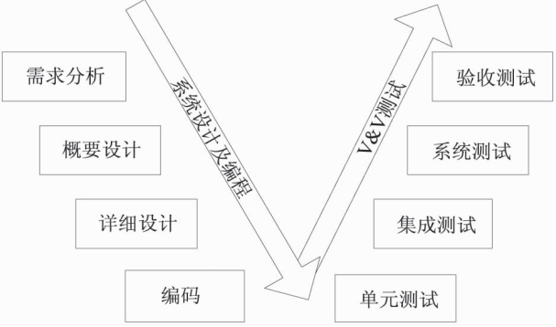
V模型
V模型
V模型是一种可以反映 V&V活动与需求分析和设计之间关系的模型。
图中从左到右表述了开发过程和测试过程。该模型能明确标明测试中的不同级别，同时还可以清晰地表述出测试阶段和开发过程各阶段之间的对应关系。
验证阶段
确认阶段

Slide 13
V模型
验收测试与用户需求对应。
在系统分析人员作系统分析，编写需求说明书的时候测试人员根据客户需求说明书，写出最后能实现系统功能的各种测试用例
做模块功能分析及模块接口，数据传输方法的时候，把集成测试用例根据概要设计中模块功能及接口等实现方法编写出。
研发人员做详细设计的时候，相应的测试人员将单元测试用例写出。

Slide 14
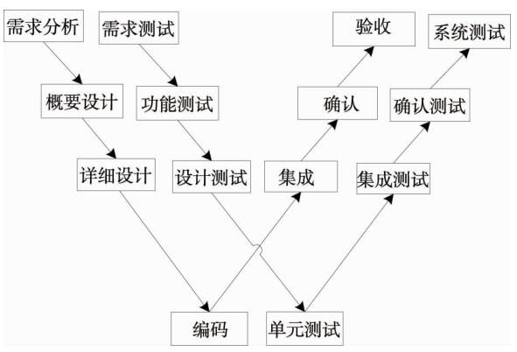
W模型
W模型
基于 V&V 原理的 W 模型实际上就是存在两个
“V”，一个是实际的软件开发过程，另一个则是与软件开发工程相对应的测试过程。
W模型可以认为是V 模型的发展，其所强调的是测试和开发两者间的同步进行，验证和确认活动将伴随整个软件开发周期。
测试的对象也不限于程序编码，需求及设计也一样需要进行确认。

Slide 15
思考题
V&V的区别和联系如何？
Review&Audit与V&V的关系如何？

Slide 16
Verification and Validation

Slide 17
Objectives
To introduce software verification and validation and to discuss the distinction between them
To describe the program inspection process and its role in V & V
To explain static analysis as a verification technique
To describe the Cleanroom software development process

Slide 18
Topics covered
Verification and validation planning
Software inspections
Automated static analysis
Cleanroom software development

Slide 19
Verification vs validation
Verification: "Are we building the product right”.
The software should conform to its specification.
Validation: "Are we building the right product”.
The software should do what the user really requires.

Slide 20
The V & V process
Is a whole life-cycle process - V & V must be applied at each stage in the software process.
Has two principal objectives
The discovery of defects in a system;
The assessment of whether or not the system is useful and useable in an operational situation.

Slide 21
V& V goals
Verification and validation should establish confidence that the software is fit for purpose.
This does NOT mean completely free of defects.
Rather, it must be good enough for its intended use and the type of use will determine the degree of confidence that is needed.

Slide 22
V & V confidence
Depends on system’s purpose, user expectations and marketing environment
Software function
The level of confidence depends on how critical the software is to an organisation.
User expectations
Users may have low expectations of certain kinds of software.
Marketing environment
Getting a product to market early may be more important than finding defects in the program.

Slide 23
Static and dynamic verification
Software inspections. Concerned with analysis of the static system representation to discover problems (static verification)
May be supplement by tool-based document and code analysis
Software testing. Concerned with exercising and observing product behaviour (dynamic verification)
The system is executed with test data and its operational behaviour is observed

Slide 24
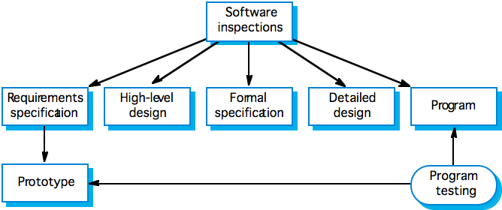
Static and dynamic V&V

Slide 25
Program testing
Can reveal the presence of errors NOT their absence.
The only validation technique for non-functional requirements as the software has to be executed to see how it behaves.
Should be used in conjunction with static verification to provide full V&V coverage.

Slide 26
Types of testing
Defect testing
Tests designed to discover system defects.
A successful defect test is one which reveals the presence of defects in a system.
Validation testing
Intended to show that the software meets its requirements.
A successful test is one that shows that a requirements has been properly implemented.

Slide 27
Testing and debugging
Defect testing and debugging are distinct processes.
Verification and validation is concerned with establishing the existence of defects in a program.
Debugging is concerned with locating and repairing these errors.
Debugging involves formulating a hypothesis about program behaviour then testing these hypotheses to find the system error.

Slide 28
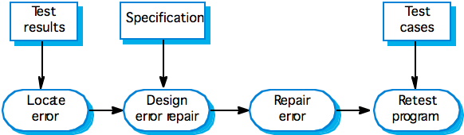
The debugging process

Slide 29
V & V planning
Careful planning is required to get the most out of testing and inspection processes.
Planning should start early in the development process.
The plan should identify the balance between static verification and testing.
Test planning is about defining standards for the testing process rather than describing product tests.

Slide 30
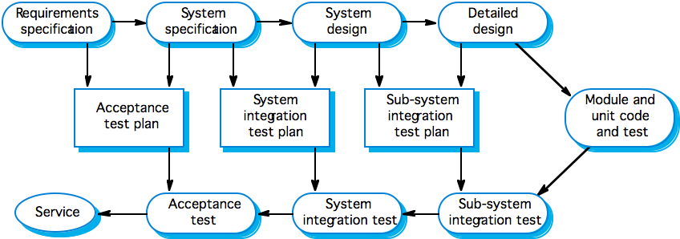
The V-model of development

Slide 31
The structure of a software test plan
The testing process.
Requirements traceability.
Tested items.
Testing schedule.
Test recording procedures.
Hardware and software requirements.
Constraints.

Slide 32
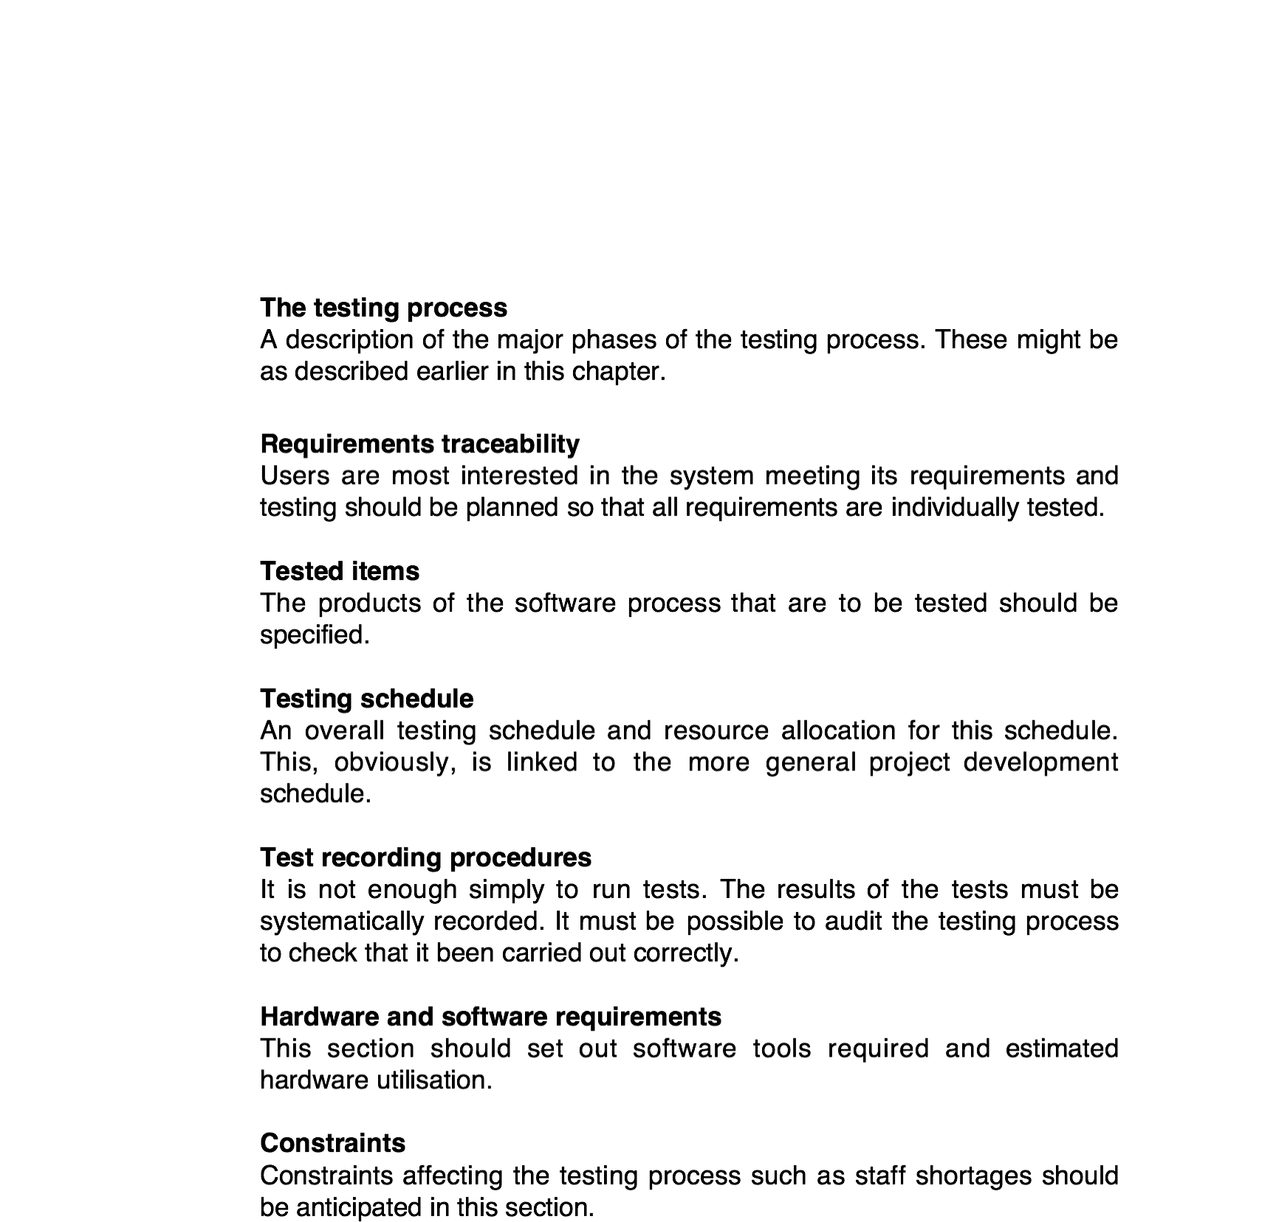
The software test plan

Slide 33
Software inspections
These involve people examining the source representation with the aim of discovering anomalies and defects.
Inspections not require execution of a system so may be used before implementation.
They may be applied to any representation of the system (requirements, design,configuration data, test data, etc.).
They have been shown to be an effective technique for discovering program errors.

Slide 34
Inspections and testing
Inspections and testing are complementary and not opposing verification techniques.
Both should be used during the V & V process.
Inspections can check conformance with a specification but not conformance with the customer’s real requirements.
Inspections cannot check non-functional characteristics such as performance, usability, etc.

Slide 35
Program inspections
Intended explicitly for defect detection (not correction).
Defects may be logical errors, anomalies in the code that might indicate an erroneous condition (e.g. an uninitialised variable) or non-compliance with standards.

Slide 36
Inspection pre-conditions
A precise specification must be available.
Team members must be familiar with the organisation standards.
Syntactically correct code or other system representations must be available.
An error checklist should be prepared.
Management must accept that inspection will increase costs early in the software process.
Management should not use inspections for staff appraisal i.e. finding out who makes mistakes.

Slide 37
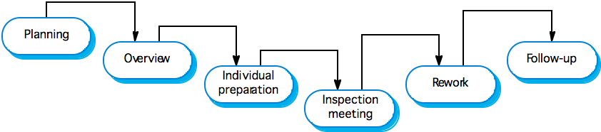
The inspection process

Slide 38
Inspection procedure
System overview presented to inspection team.
Code and associated documents are distributed to inspection team in advance.
Inspection takes place and discovered errors are noted.
Modifications are made to repair discovered errors.
Re-inspection may or may not be required.

Slide 39
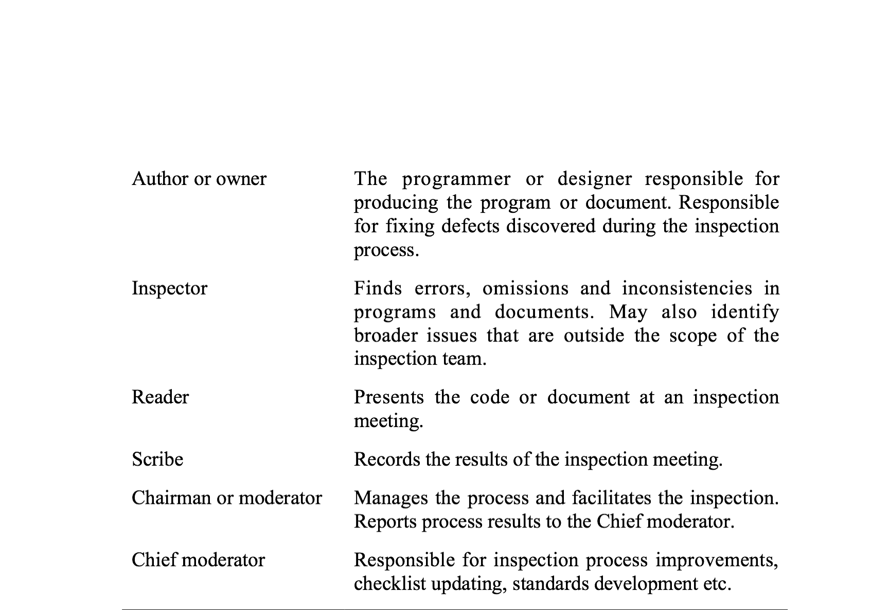
Inspection roles

Slide 40
Inspection checklists
Checklist of common errors should be used to drive the inspection.
Error checklists are programming language dependent and reflect the characteristic errors that are likely to arise in the language.
In general, the 'weaker' the type checking, the larger the checklist.
Examples: Initialisation, Constant naming, loop termination, array bounds, etc.

Slide 41
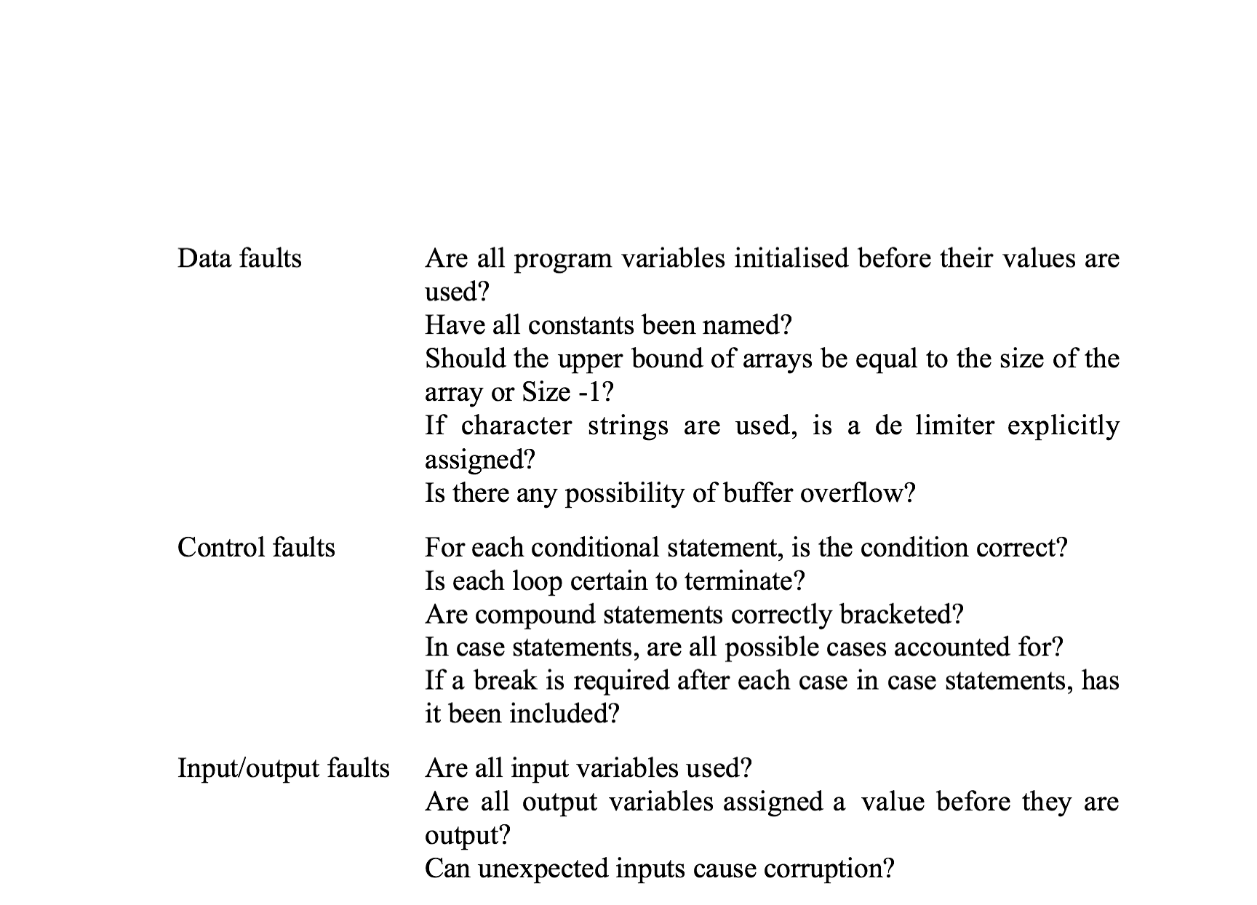
Inspection checks 1

Slide 42
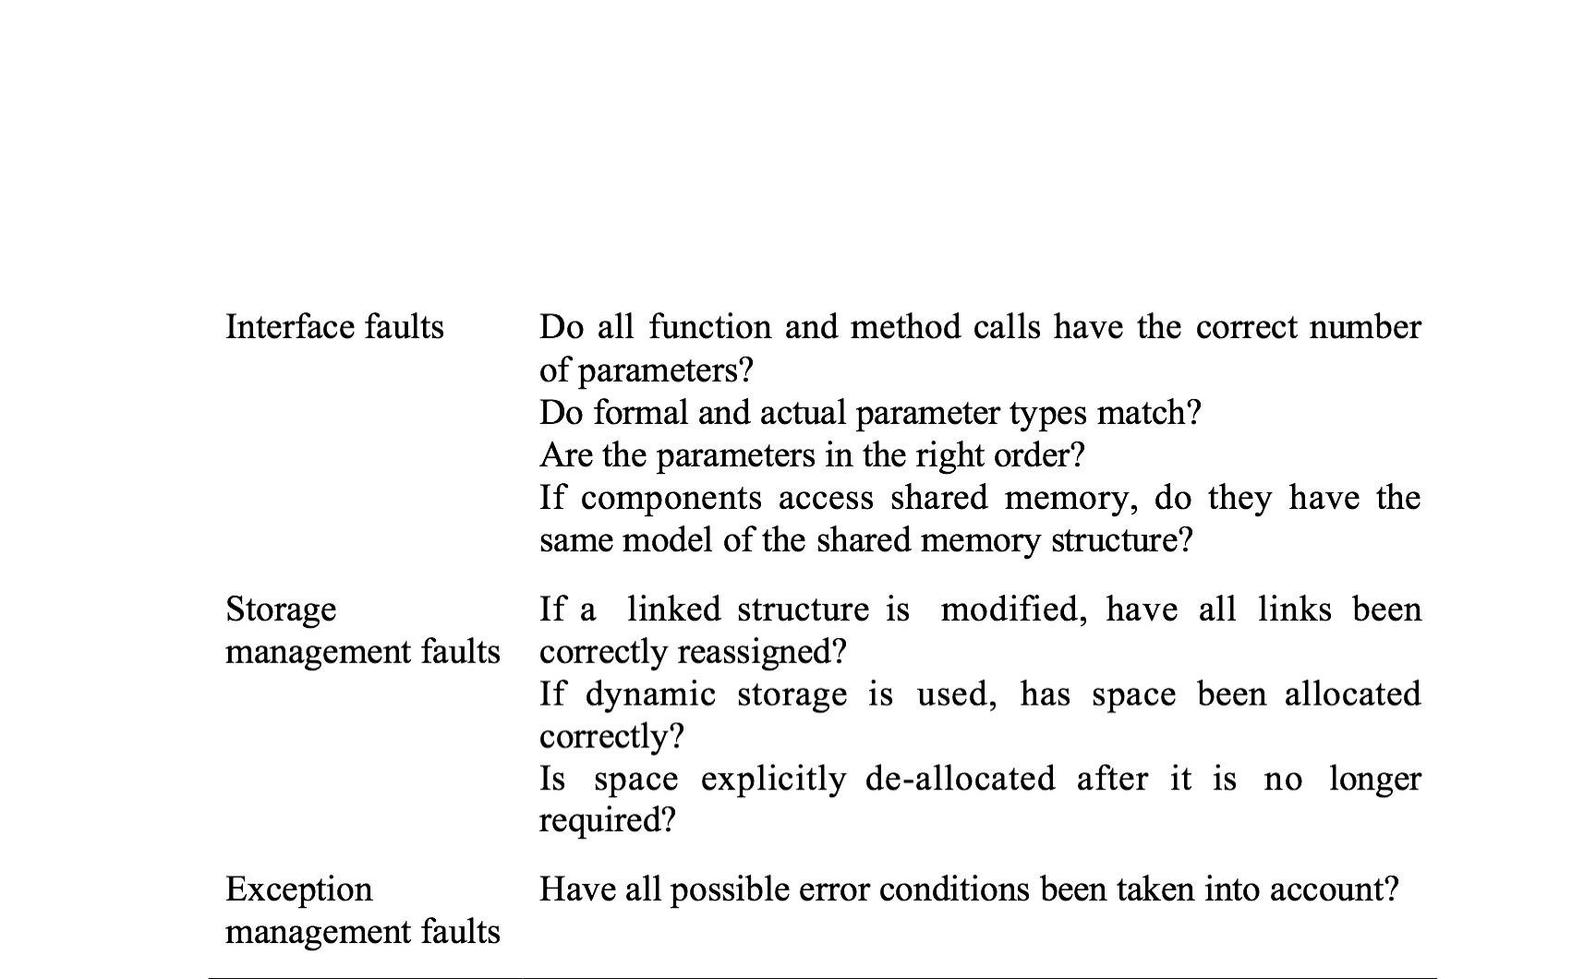
Inspection checks 2

Slide 43
Automated static analysis
Static analysers are software tools for source text processing.
They parse the program text and try to discover potentially erroneous conditions and bring these to the attention of the V & V team.
They are very effective as an aid to inspections - they are a supplement to but not a replacement for inspections.

Slide 44
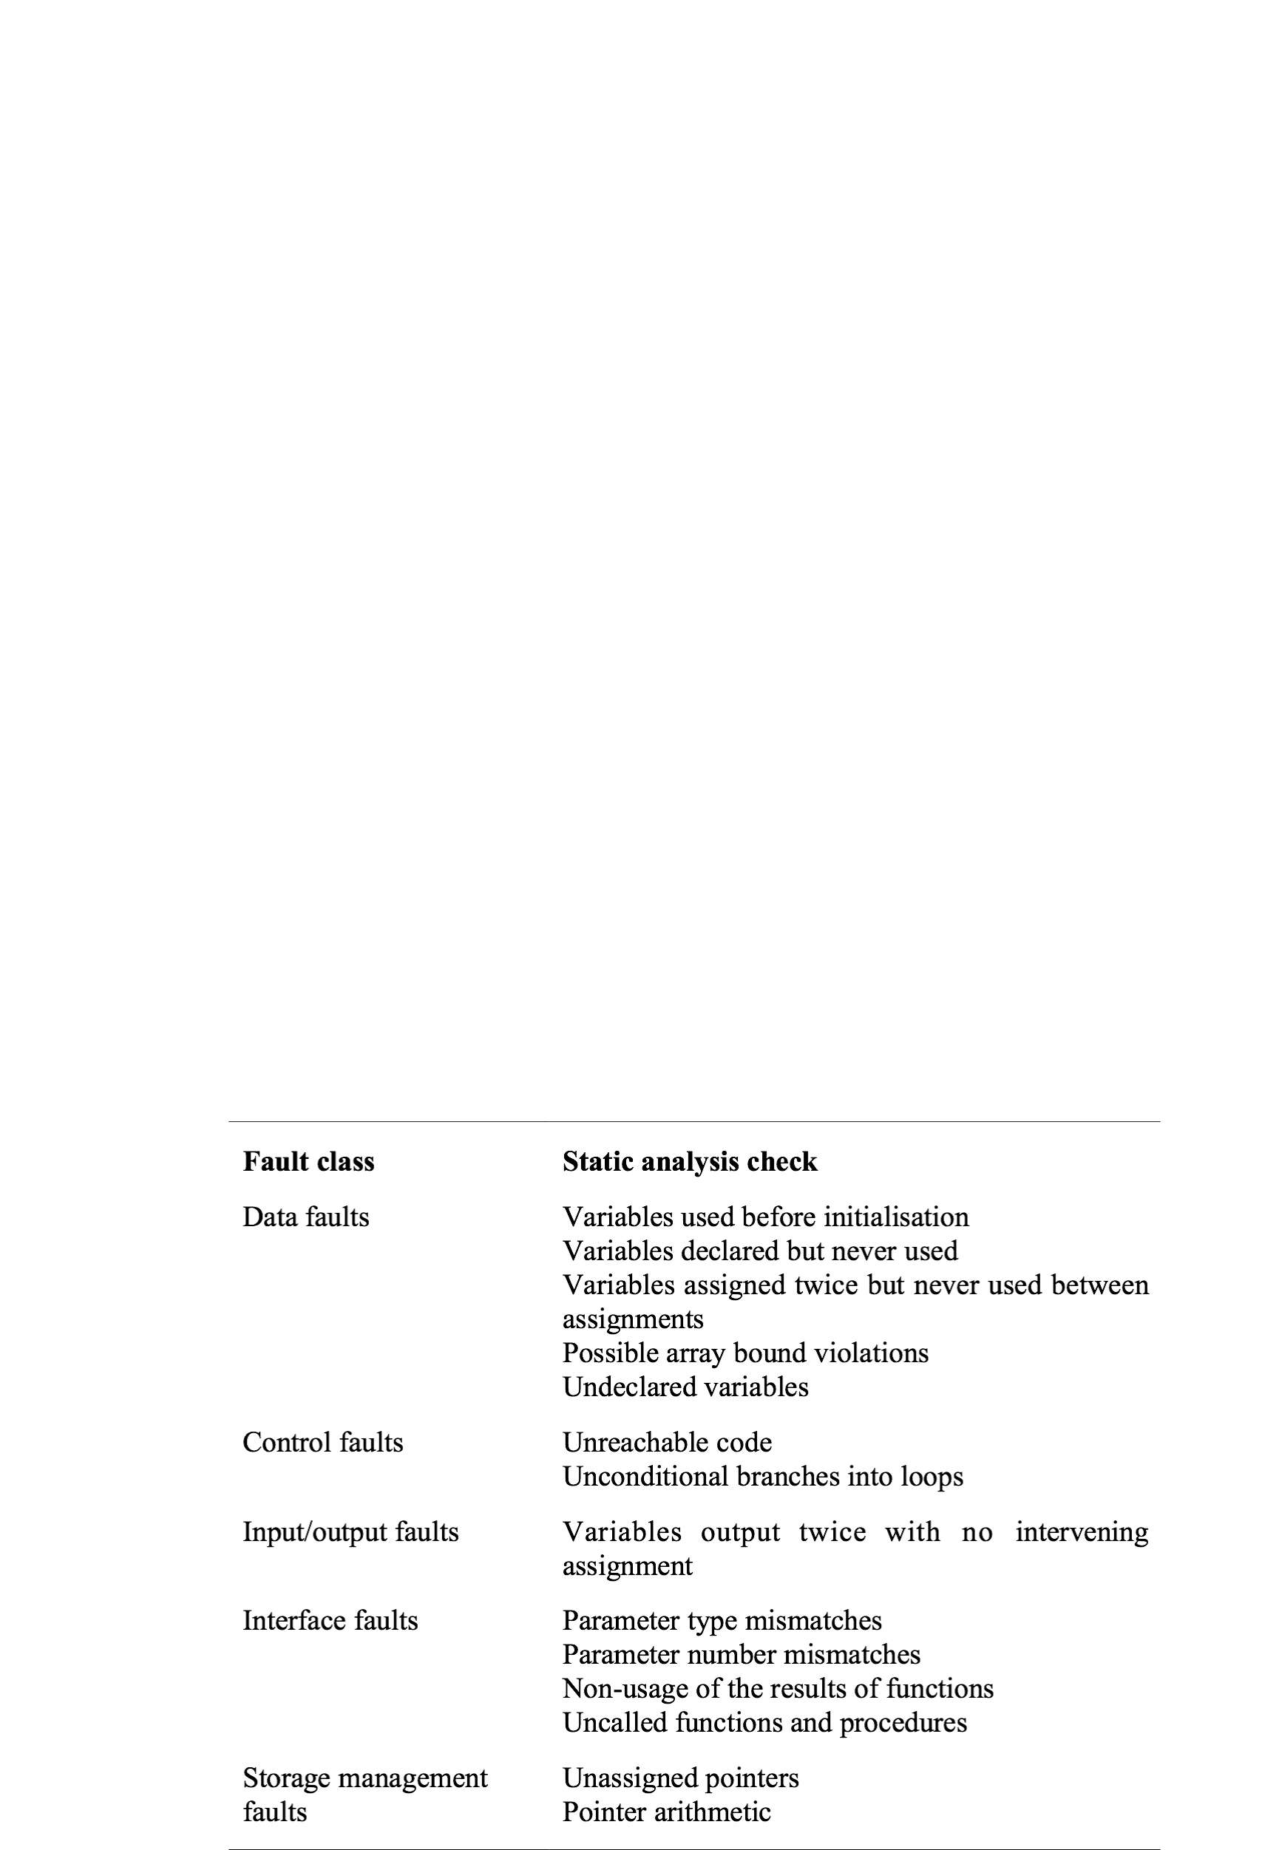
Static analysis checks

Slide 45
Stages of static analysis
Control flow analysis. Checks for loops with multiple exit or entry points, finds unreachable code, etc.
Data use analysis. Detects uninitialised variables, variables written twice without an intervening assignment, variables which are declared but never used, etc.
Interface analysis. Checks the consistency of routine and procedure declarations and their use

Slide 46
Stages of static analysis
Information flow analysis. Identifies the dependencies of output variables. Does not detect anomalies itself but highlights information for code inspection or review
Path analysis. Identifies paths through the program and sets out the statements executed in that path. Again, potentially useful in the review process
Both these stages generate vast amounts of information. They must be used with care.

Slide 47
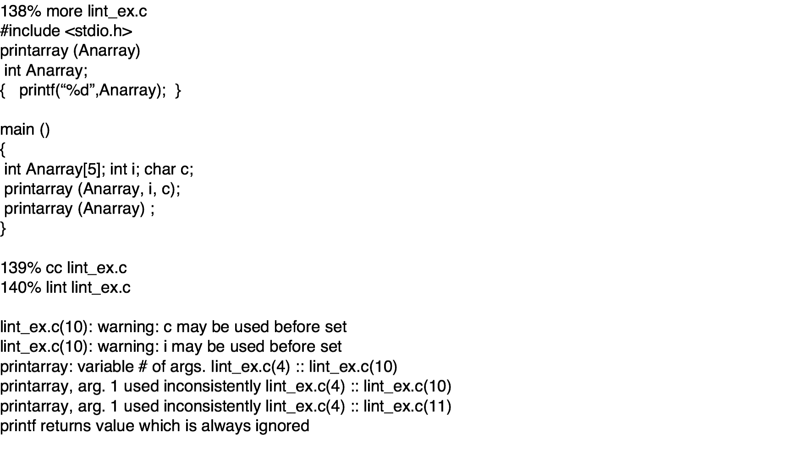
LINT static analysis

Slide 48
Use of static analysis
Particularly valuable when a language such as C is used which has weak typing and hence many errors are undetected by the compiler,
Less cost-effective for languages like Java that have strong type checking and can therefore detect many errors during compilation.

Slide 49
Verification and formal methods
Formal methods can be used when a mathematical specification of the system is produced.
They are the ultimate static verification technique.
They involve detailed mathematical analysis of the specification and may develop formal arguments that a program conforms to its mathematical specification.

Slide 50
Cleanroom software development
The name is derived from the 'Cleanroom' process in semiconductor fabrication. The philosophy is defect avoidance rather than defect removal.
This software development process is based on:
Incremental development;
Formal specification;
Static verification using correctness arguments;
Statistical testing to determine program reliability.

Slide 51
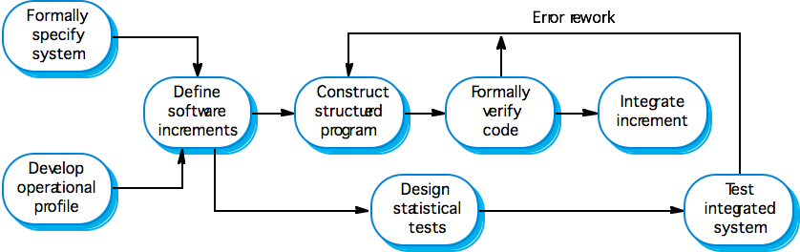
The Cleanroom process

Slide 52
Key points
Verification and validation are not the same thing. Verification shows conformance with specification; validation shows that the program meets the customer’s needs.
Test plans should be drawn up to guide the testing process.
Static verification techniques involve examination and analysis of the program for error detection.

Slide 53
Key points
Program inspections are very effective in discovering errors.
Program code in inspections is systematically checked by a small team to locate software faults.
Static analysis tools can discover program anomalies which may be an indication of faults in the code.
The Cleanroom development process depends on incremental development, static verification and statistical testing.

